Slide 1
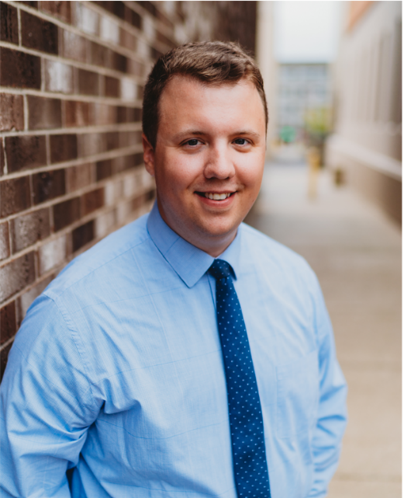
Grant Funding Available
for Michigan Libraries!
MID-MICHIGAN LIBRARY LEAGUE
Annual Meeting of the Membership
September 15, 2022
Alex Flannery
Operational Support Program Manager
517-331-5925 flannerya1@michigan.org

Slide 2
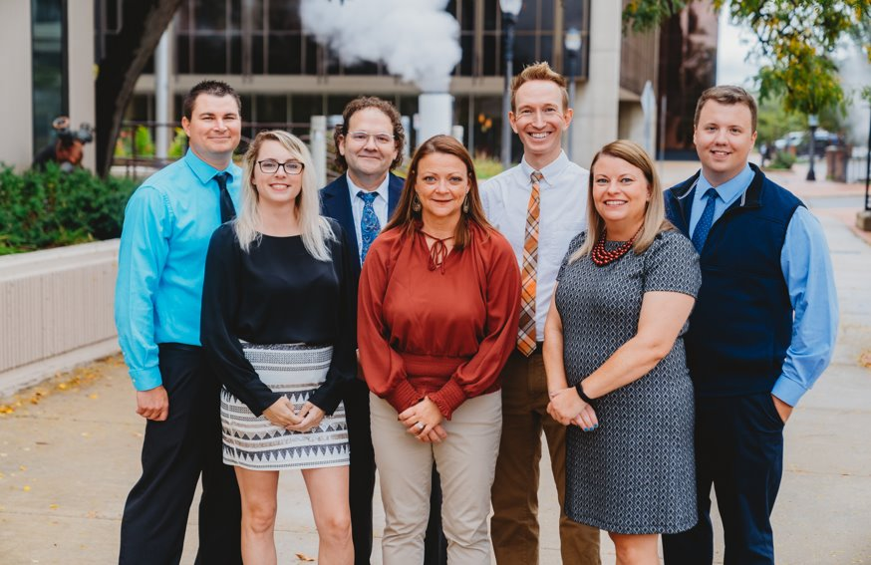
WHO WE ARE
State of Michigan’s Arts and Culture Council established in the 1960's to provide access and opportunities in the arts and culture sector in Michigan.
WHAT WE DO
Provide state and federal appropriated dollars to arts and cultural organizations and other eligible entities through a competitive grant making process.
WHY WE DO IT
To encourage, initiate and facilitate an enriched artistic, cultural and creative environment in Michigan.
MACC Staff (7)
Governor-Appointed Council (15)
Gretchen Gonzales Davidson, Chair, Birmingham
Anne Belanger, Rogers City
Darryl Brown, St. Ignace
Cezanne Charles, Ann Arbor
Sigal Hemy, Pleasant Ridge
Nheena Ittner, Marquette
Joori Jung, Detroit
Anessa Kramer, Bloomfield Hills
Deborah Mikula, Howell
Jessica Care Moore, Detroit
Amy Spadafore, Saginaw
Ara Topouzian, Farmington Hills
Rhonda Welsh, Troy
Germaine Williams, Detroit
Kate Yancho, Kalamazoo

Slide 3
Today’s Agenda
Is my library eligible for MACC grants (yes!), and which ones? What are some examples?
How do I get started? Who can I contact?
Time for questions. Ask me anything about MACC!

Slide 4
Two Eligibility Tracks Apply for up to 5 different grants annually!
Municipal Libraries
Project Support Grant
Nonprofit Libraries
Operational Support Grant
All Library Types
Capital Improvement Grant
New Leaders Grant (won’t be discussed today, but included on website & in packet)
Minigrant Arts/Culture Projects
Minigrant Professional/Organizational Development

Slide 5
Project Support
Project Support Grant
Funding to enact an arts/culture project in your library and/or community.
Municipal Libraries Only
Next Project Support Deadline: Spring 2023 (likely June 1, subject to change)
Apply Annually

Slide 6
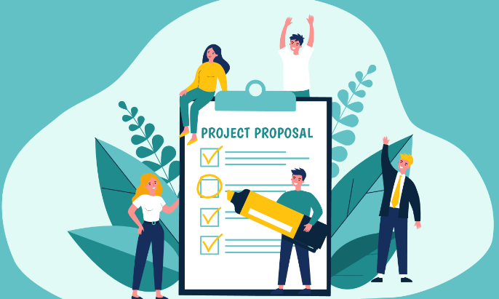
Project Support
MACC Project Support Basics
$5,000-$30,000 for an arts/culture project
1:1 cash match, no in-kind.
Projects can be anything from 1 day to 1 year long.
Eligible Expenses
Artist/Culture-Bearer/Historian fees
In-state travel for artists
Marketing
Consumable Supplies related to instructional component of the project (participants take supplies home i.e. books)
Staff time directly related to the execution of the grant program

Slide 7
Project Support
MACC Project Support Examples - Libraries
$10,500
Brings storytellers from across nation to Jackson to tell stories to over 15,000 people ages 0-100+
3 Day Event held in schools, local museum, and local theatres.
$21,000
Supports two programs: The Summer Reading Challenge (maintain reading skills when school is out of session) and One Book, One City for Kids (fifth graders read and discuss issues of the books they read)
$4,720
“Black History Month Blues Series”
6 free concerts featuring blues and roots artists in accessible locations throughout Monroe County.
Main partner: Ellis Library & Reference Center

Slide 8
Operational Support
Operational Support Grant
Funding to “pay the bills”
Nonprofit Libraries Only
Next O.S. Deadline: Spring 2023 (likely June 1, subject to change)
Apply Annually

Slide 9
Operational Support
MACC Operational Support Basics
Operable for at least the last 3 years (COVID-shutdowns acceptable)
Each year needs a minimum budget size (unrestricted revenues) of $10,000
Eligible expenses: "Pay the bills grant”
Salaries/Wages/Artist Fees/Contractors/Honoraria/Residencies
Marketing expenses
Supplies (performance, production costs)
Administrative fees
Equipment rental, space rental, facility mortgage
Technology costs
Facility maintenance
Market research, visitor studies, strategic planning
Recording costs

Slide 10
MACC Operational Support Basics
1:1 cash match (no-kind)
Requests: $5,000-$60,000 (cannot exceed 50% of your operating budget, OR the maximums listed below)
Operational Support

Slide 11
Capital Improvement
Capital Improvement Grant
Funding to purchase equipment or
facility enhancement.
All Library Types Eligible
Next Capital Improvement Deadline: Spring 2023 (likely June 1, subject to change)
Apply Annually

Slide 12
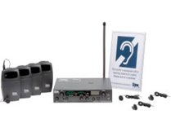
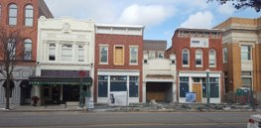
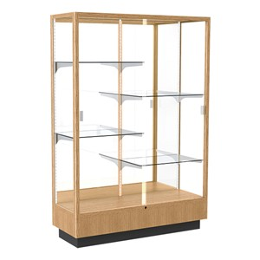
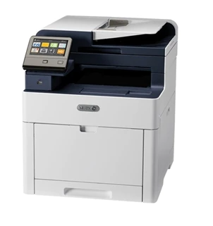
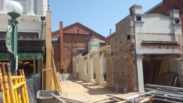
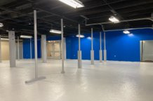
MACC Capital Improvement Basics
Equipment OR Facility Enhancement
Non-permanent, could take with you
Permanent, need building ownership or long-term lease
Capital Improvement

Slide 13
MACC Capital Improvement Basics
Request amount: $5,000-$100,000
1:1 cash match and/or newly manufactured product in-kind match. Labor not eligible as in-kind.
Project should be shovel-ready (or very close). Project must be completed within grant period (one year).
Think about: Accessibility, Productivity, Efficiency
Capital Improvement

Slide 14
Capital Improvement
MACC Capital Improvement Examples - Libraries
$23,850
FY22- Roof Replacement (leaking onto bookshelves, damaging books)
Applied again in FY23 for carpet replacement (damage from leaking roof)
$26,600
Owns “Rogers City Theater”
Structural restoration of building’s north wall
Includes installation of fire escape stairs and restoration of disintegrating concrete
$50,000
Modernize library operations and patron service
Installed security gates (prevents theft via RFID tags)
RFID also enables self-checkout capability, installed kiosks
Purchase laptops for patron use/checkout within building

Slide 15
New Leaders
New Leaders Grant
Funding to allow young person(s) to lead a project for your library. (up to $4,000)
All Library Types Eligible
Next New Leaders Deadline: Spring 2023 (likely June 1, subject to change)
Apply Annually

Slide 16
Minigrant Arts Project
Minigrant Arts Project Grant
Funding for smaller-scale arts and culture projects
All Library Types Eligible
Next Minigrant Arts Project Deadline: 2023 (Minigrant deadlines vary)
Apply annually
Cannot receive in addition to Project Support or Operational Support

Slide 17
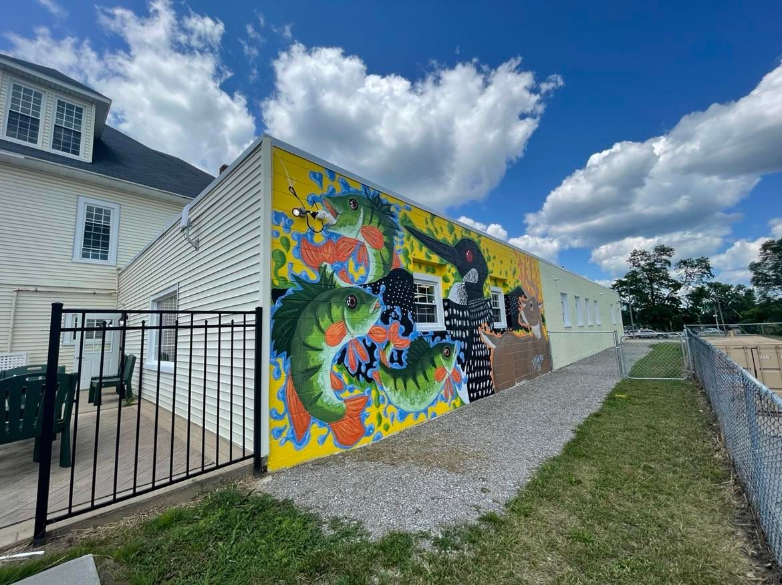
Minigrant Arts Projects
Eligible for MACC Minigrant Arts Project
Up to $4,000 to address arts and cultural needs in your communities
1:1 match with cash and/or in-kind match
Competes only regionally with other Minigrant applicants

Slide 18
Minigrant Arts Projects
MACC Minigrant Arts Project Examples - Libraries
$3,250 for “Oceans of Possibilities” project
Seven weekly artistic performances for PreK-5th and families.
Three weekly performances for grades 6-12.
$3,500 for Summer Reading Club for children, teens, and adults
June to August
Weekly story time presentations and arts/crafts programs.
$3,200 for community art event
Project culminates in community painting of outdoor mural on library annex building (anyone can paint, or come to enjoy the creativity and connections)
Mural designed by local artists along with high school art students.

Slide 19
Minigrant Professional/ Organizational Development (POD)
Minigrant POD Grant
(Professional/Organizational Development)
All Library Types Eligible.
Next Minigrant POD Deadline: 2023 (Minigrant deadlines vary)
Apply Annually
**Currently MACC’s only grant opportunity for individuals**

Slide 20
Minigrant Professional/ Organizational Development (POD)
MACC Minigrant POD Basics
Up to $1,500 with a 1:4 cash and/or in-kind match
Two funding tracks (choose one per year)
Professional Development for Individual Administrators/Library Staff/Library Boards/Volunteers
Conference/Education/Training -- to increase knowledge/skills
Organization-Wide Development for any Library
Outside Consultant -- Hire a facilitator or consultant to improve your organization
What can I spend it on?
Artist, consultant, workshop, registration fees directly related to POD opportunity
Travel (in OR out of state)
Meals and Lodging
Project-related Materials
Consultant fees

Slide 21
Minigrant Professional/ Organizational Development (POD)
MACC Minigrant Professional/Organizational Development (POD) Examples:
Examples of Organizational Development (hire a consultant):
Strategic planning
Coalition building
Fundraising planning
Needs assessment
Grant writing
Board governance
Marketing/Rebranding
Send your staff to conferences (pays for travel out-of-state, conference fees, food, lodging)
POD Grants can be for in-person or virtual opportunities!

Slide 22
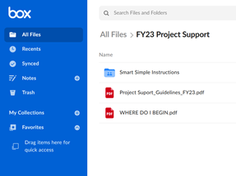
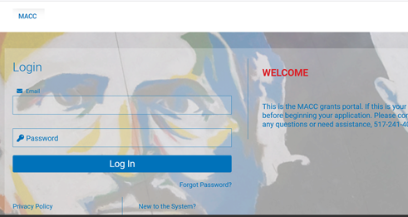
How to get started on a MACC Grant
1.
2.
3.
www.michigan.gov/arts
More information about each grant opportunity
macc.smartsimple.com
Register in our Grants Portal to Submit Application
Access guidelines
Start-to-finish instructions for writing an application

Slide 23
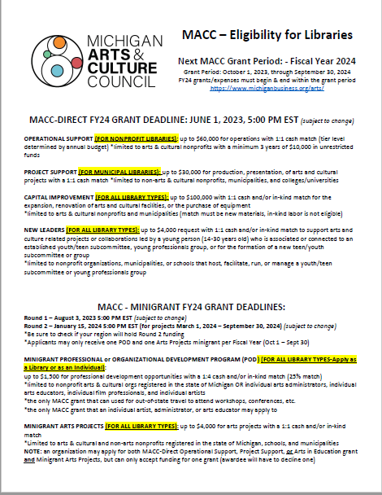
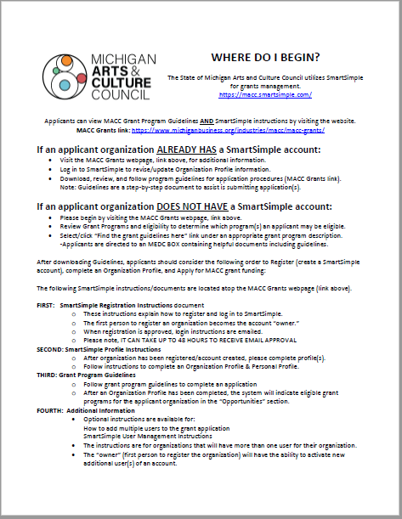
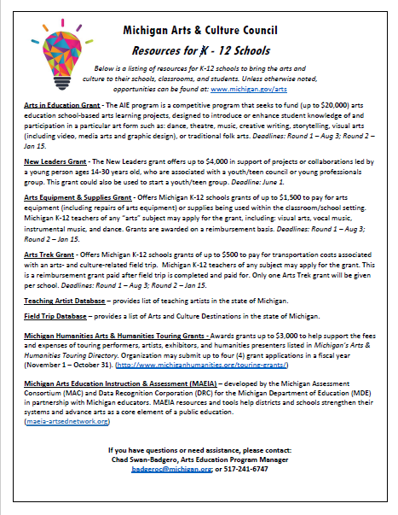
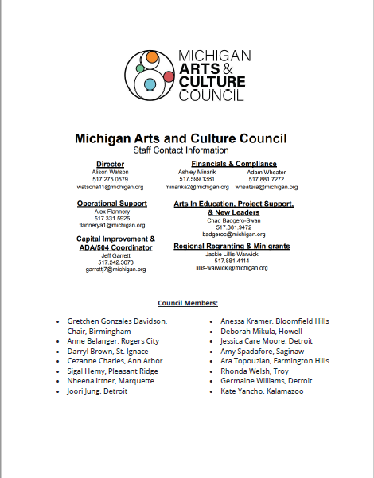
Take-Home Materials
Feel free to contact me (Alex) for any digital materials, copy of slideshow, questions, etc.
Overview of MACC grants for libraries & grant examples
How do I begin on preparing a MACC application?
List of K-12 MACC grants. Please make available at your library!
MACC Staff Contact Information & Council Listing

Slide 24
Contact us! We're here to help!
Director
Alison Watson: 517.275.0579
watsona11@michigan.org
Finance, Compliance, & SmartSimple
Adam Wheater: 517.881.7272 wheatera@michigan.org
Finance & Compliance
Ashley Minarik: 517.599.1381 minarika2@michigan.org
Operational Support
Alex Flannery: 517.331.5925 flannerya1@michigan.org​
​
Capital Improvement, ADA 504 Coordinator
Jeff Garrett: 517.242.3678 garrettj7@michigan.org
​
Project Support, New Leaders, Arts in Education​
Chad Swan-Badgero: 517.881.9472 badgeroc@michigan.org
Regional Regranting /Minigrants
​Jackie Lillis-Warwick 517.881.4114 lillis-warwickj@michigan.org
​
​
​

Slide 25
Michigan Arts and Culture Council: Grant Funding Available
for Michigan Libraries!
MID-MICHIGAN LIBRARY LEAGUE
Annual Meeting of the Membership
September 15, 2022
Alex Flannery
Operational Support Program Manager
517-331-5925 flannerya1@michigan.org

Slide 26
New Leaders
MACC New Leaders Basics
Required: Project LED BY a young person who makes key decisions (ages 14-30)
Required: Project is connected to (or creates) a youth/teen council or young professionals group focused on arts and culture
Request amount: up to $4,000.
1:1 cash and/or in-kind match.
Expenses: artist fees, in-state travel/lodging, marketing, consumable supplies related to project
$2,800
Established a teen council
Teens create and produce annual summer celebration: Noise Permit
Event is “by teens for teens”
Twice weekly mentoring of teens on artistic/cultural projects, culminates in a final summer concert to share their works.
Music, writing, spoken word, dance, etc.

